Slide 1
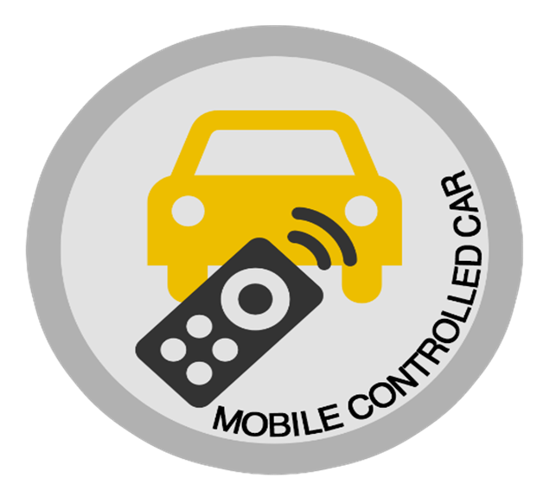
Title :- Smartphone Controlled Car Using Arduino
Subject :- IOT Mini Project
Project Mentor :- Ahmar Usmani
Group Member:-
Member Names | Roll No.
Akshay Shingte | 56
Siddhant Sawant | 34
3. Shubham Yadav | 42

Slide 2
Introduction
Modules :-
In this project we show you how to make a android phone controlled car using Bluetooth module and Arduino Uno Board .Overall this project cover everything you need to build up a mobile controlled car (Hardware + coding).We are using Arduino IDE software for compiling the code and Bluetooth RC control mobile app for moving the car.
Statement:-
After supplying the vehicle with voltage
» we turn the mobile Bluetooth
» using android application to connect with the Bluetooth modules on the vehicle.
Benifits to Consumer :-
Arduino has benefits like it is open Source, Flexible, Easy to Use and online community.
Save Time and Energy during non-verbal communication.
Security purpose through camera and speaker with microphone.

Slide 3
Abstract
Many of the wireless-controlled robots use RF modules. But this project make use of Android mobile phone for robotic control.
Abstract problem :-
As the car is connected by Bluetooth module the range will not be great enough to control it from long distance.
Problem Solving:-
We can use this car in small geographical areas
For spying and surveillance we are using Arduino camera.
we are using speaker and microphone for Communication.
We are using this car in military purposes.

Slide 4
LITERATURE SURVEY
1. Android mobile phone controlled Bluetooth robot or car using 8051
Microcontroller :-http://www.ijser.in/archives/v2i7/SjIwMTMzMjQ=.pdf
2. Android smartphone control unit for search missions:-
https://ieeexplore.ieee.org/abstract/document/6845227
3. Arduino based Smartphone controlled car :-
https://ieeexplore.ieee.org/abstract/document/7087683/
https://patents.google.com/patent/US9569954B2/en

Slide 5
Required Hardware
Hardware:-
4WD Robot chasis Kit
200 rpm Motor
LM 298 H Bridge Module
0.5 Square mm Wires
Power Adapter(9-24v)
20 cm Male to male jumper wires
20cm Male to Female jumper Wires
Arduino Uno and Cable
Bluetooth Module
Softwares:-
Arduino IDE
Bluetooth RC mobile App

Slide 6
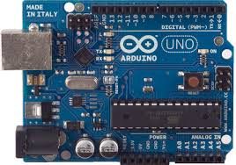
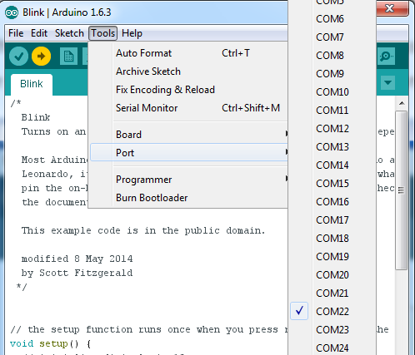
System Architecture
Arduino UNO will be the brain of the robotic car as it will be running
the software that will control all the other parts .

Slide 7
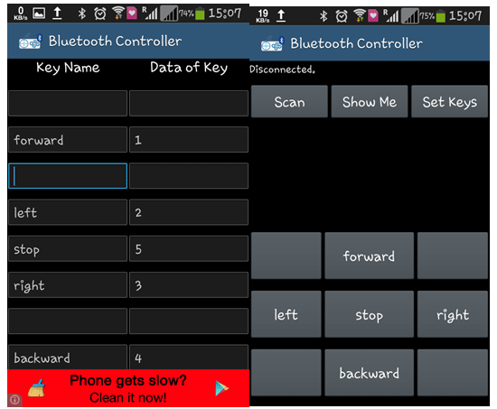
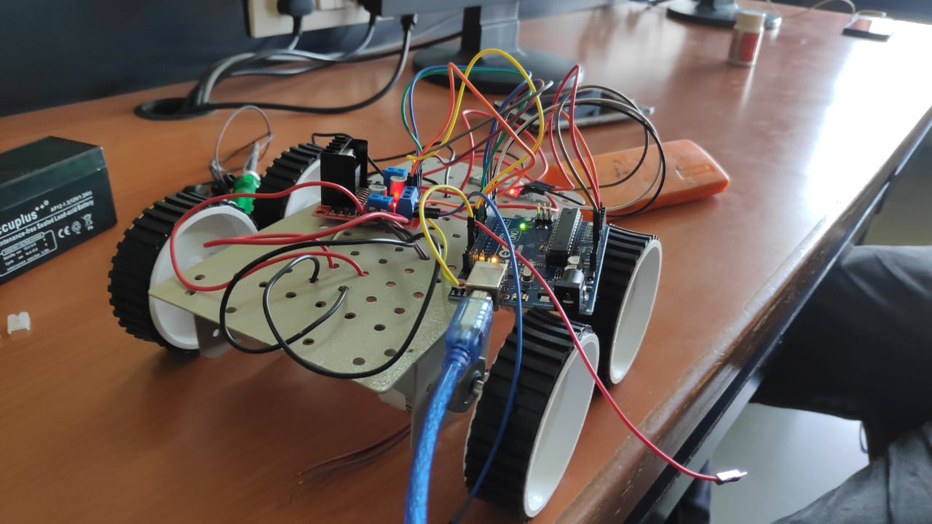
Architecture of car
Bluetooth Control App

Slide 8
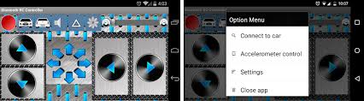
Implementation
This car have four dc motors two at its front and two at rear side. Front side motor is used for giving direction to car means turning left or right side (like real car steering feature). And rear side motor is used for driving the car in forward and backward direction. A Bluetooth module is used to receive command from android phone and Arduino UNO is used for controlling the whole system.
Bluetooth controlled car moves according to button touched in the android Bluetooth mobile app. To run this project first we need to download Bluetooth app form Google play store. We can use any Bluetooth app that supports or can send data. Here are some apps' name that might work correctly.
- Bluetooth control car
- Circuit Ninja
After installing app you need to open it and then search Bluetooth device and select desired Bluetooth
device. And then configure keys. Here in this project we have used Bluetooth controller app.
Download and install Bluetooth Controller.
Turned ON mobile Bluetooth.
Now open Bluetooth controller app
Press scan
Select desired Bluetooth device
Now set keys by pressing set buttons on screen.

Slide 9
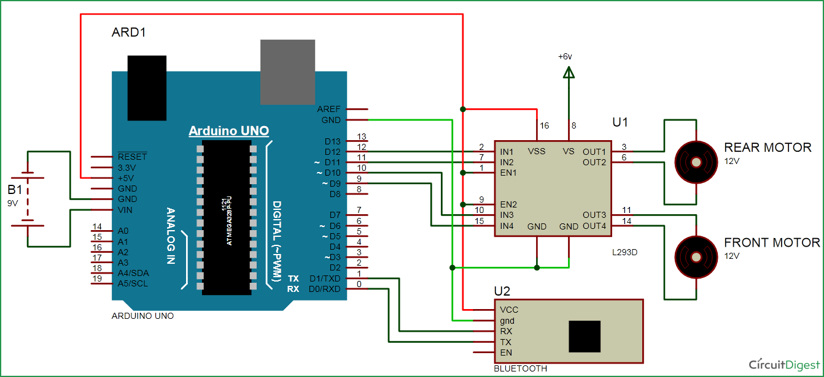
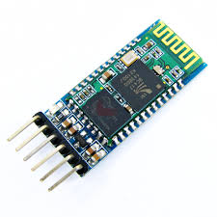
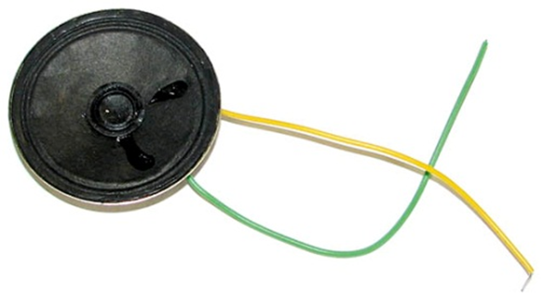
Overview Of Circuit
Circuit diagram for bluetooth controlled car is shown in above figure. A Motor driver is connected to arduino to run the car. Motor driver’s input pins 2, 7, 10 and 15 are connected to Arduino's digital pin number 12, 11, 10 and 9 respectively. Here we have used two DC motors to driver car in which one motor is connected at output pin of motor driver 3 and 6 and another motor is connected at 11 and 14. A 6 volt Battery is also used to power the motor driver for driving motors. Bluetooth module’s rx and tx pins are directly connected at tx and rx of Arduino. And vcc and ground pin of Bluetooth module is connected at +5 volt and gnd of Arduino. And a 9 volt battery is used for power the circuit at Arduino’s Vin pin.Which interact with mobile application to control the direction of the vehicle.
It has four pins :
VCC (Power 3.3 – 6V)
GND
TXD
RXD

Slide 10
Result and Conclusion
Future Scope :-
we achieved Blutooth control communication between the mobile -via android application- and the vehicle.
The knowledge is ever expanding and so are the problems which the mankind strive to solve. In this spirit, it is hoped that the current activity will lead to further enhancements. For example; work on future for military purpose by the robot.
1. Adding Ultrasonic Ping Sensors for obstacle avoiding
2. Using WiFi Module like ESP8266 or Node MCU instead of Bluetooth for long range control.
3. Adding a solar panel for charging the battery pack
4.Instead of using Raspberry pi we can make use of Arduino for better performance.
Touched button in Bluetooth controller app | Output for front side motor to give direction |  | Output for rear side motor to move forward or reverse direction
Button | Right | Left | Down | Up | Direction
Stop | 0 | 0 | 0 | 0 | Stop
Forward | 0 | 0 | 0 | 1 | Forward
Backward | 0 | 0 | 1 | 0 | Backward
Right | 1 | 0 | 0 | 1 | Right
left | 0 | 1 | 0 | 1 | Left

Slide 11
Result

Slide 12

REFERENCES
1.http://www.telegraph.co.uk/technology/mobile-phones/11037225.
2.http://www.arduino.cc/en/Tutorial/AnalogInputPins
3.http://learn.adafruit.com/adafruit-motor-shield/library-install.
4. https://www.youtube.com/channel/UCKpfEcbQ2y-adF-ZGOixIzA
Thank you for your attention

